Slide 1
Mid Term Report: VISUAL GAN
Prashant Khandelwal • Mentor: Yogin Patel

Slide 2
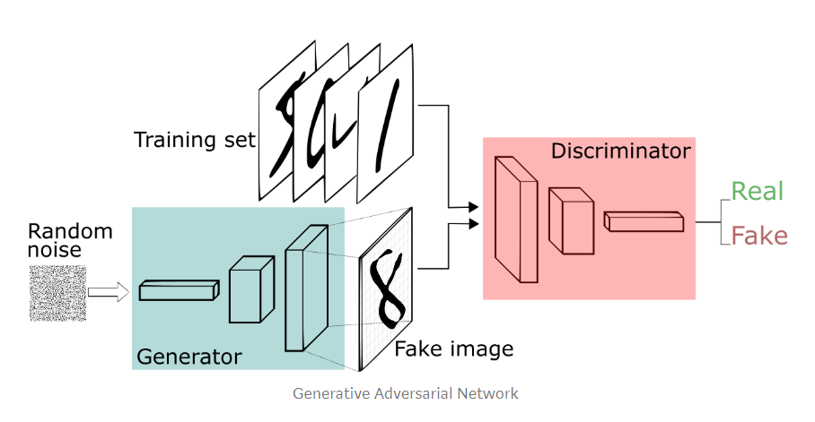
Basic GAN Working...

Slide 3
Motivation
To generate Realistic Scene-Text Images to improve Text-spotting and recognition models’ accuracy

Slide 4
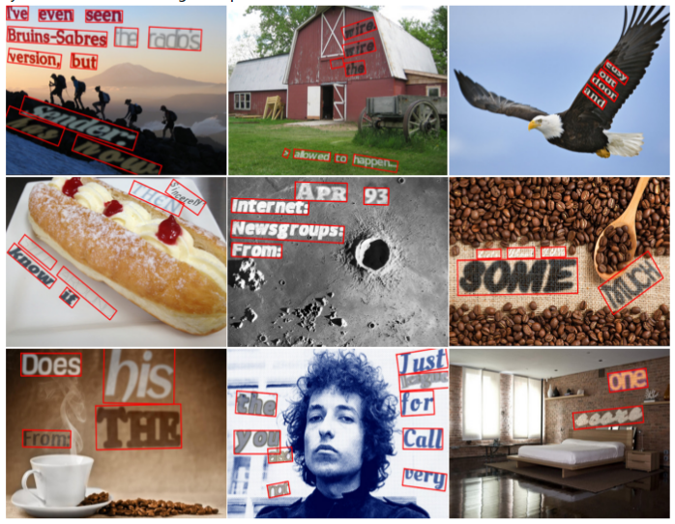
Related work and Research Papers
SynthText
Uses depth maps, segmentation and image properties.
Generated 800K images on different background images.
Limitations:
Semantics of the text regions not considered.
Appearance transfer of the embedded text is not realistic enough.

Slide 5
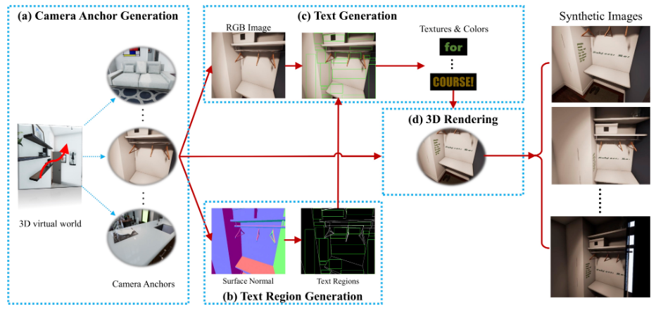
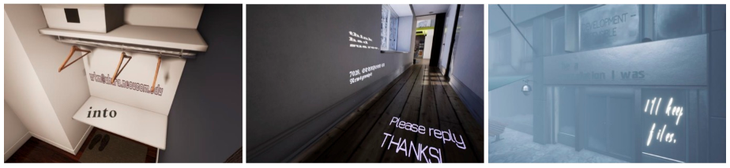
Related work and Research Papers
SynthText 3D
Uses 3D virtual scenes, hence better depth maps and segmentation masks.
Better accuracy than SynthText.
Limitations:
Camera anchors to be selected manually.
3D virtual images looses realistic nature on Scene-Text models.

Slide 6
Enables semantic coherent image synthesis.
Exploits visual saliency to determine the embedding locations within each semantic coherent region.
Adaptive text appearance model to improve text appearance.
Verisimilar Image Synthesis
for Accurate Detection and Recognition of Texts in Scenes
Scene Text Synthesis
for Efﬁcient and Effective Deep Network Training
Spatial Fusion GAN
for Image Synthesis

Slide 7
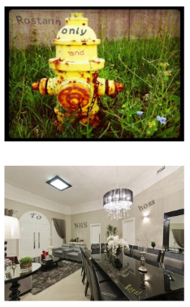
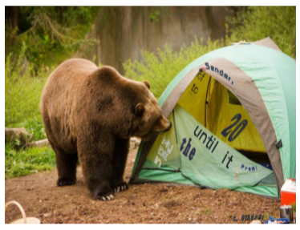


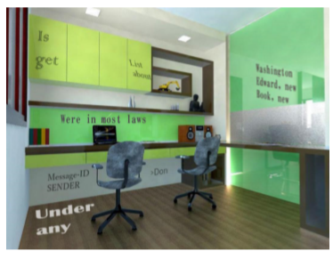

Verisimilar Image Synthesis
Scene Text Synthesis
Spatial Fusion GAN

Slide 8
Spatial Fusion GAN

Slide 9
Two Components
Geometry Synthesizer
Contains three modules:
Spatial Transform Network (STN)
Composition Module
Discriminator
Appearance Synthesizer
It aims to fuse the foreground object and background image to achieve synthesis realism in the appearance space. Contains:
Two Generators
Two Discriminators
Two Guided Filters

Slide 10
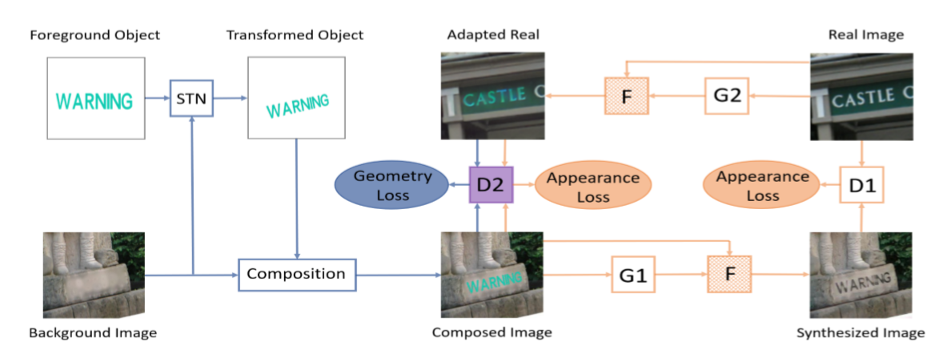
Geometry Synthesizer
Appearance Synthesizer

Slide 11
Geometry Synthesizer
Working
Understanding the motivation behind:
Spatial Transform Network (STN)
Discriminator

Slide 12
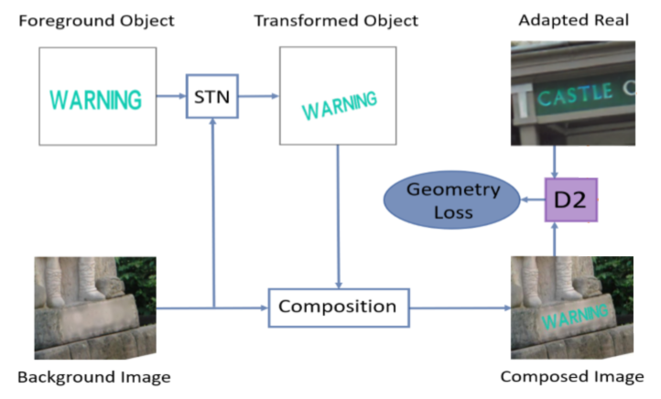
Geometry Synthesizer - Working
Foreground object and Background Image are concatenated to act as the input of STN.
D2 learns to distinguish the composed image and adapted real.
STN learns to make the composed image as similar as adapted real to fool the discriminator D2.

Slide 13
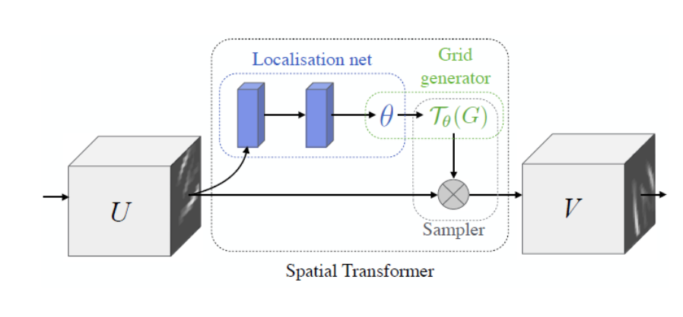
STN- Spatial Transformer Networks
Three Components
Localisation network
Grid Generator
Sampler

Slide 14
GS - Losses (Updated)
STN Loss
STN tries to fool the discriminator so that discriminator believes the composed image is the adapted real image.
pred_composed = D2(composed)
Loss = MSE(pred_composed, 1)
where ‘1’ means real images.
Discriminator Loss
Discriminator tries to distinguish between adapted real and composed image.
Let ‘1’ means real images and ‘0’ means composed images.
Loss1 = MSE(D2(real images), 1) Loss2 = MSE(D2(composed), 0)
Total Loss = average(Loss1, Loss2)

Slide 15
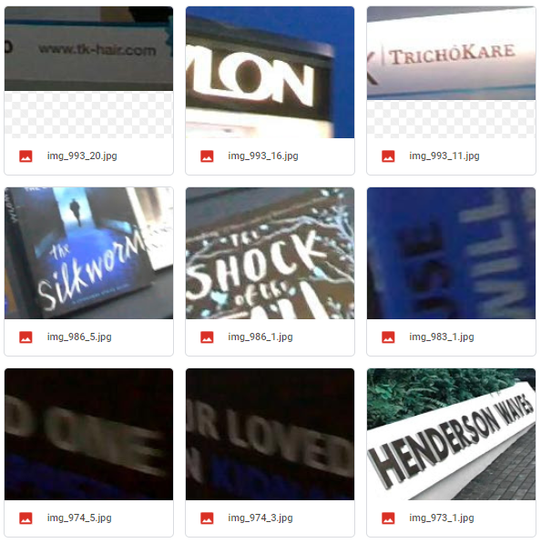
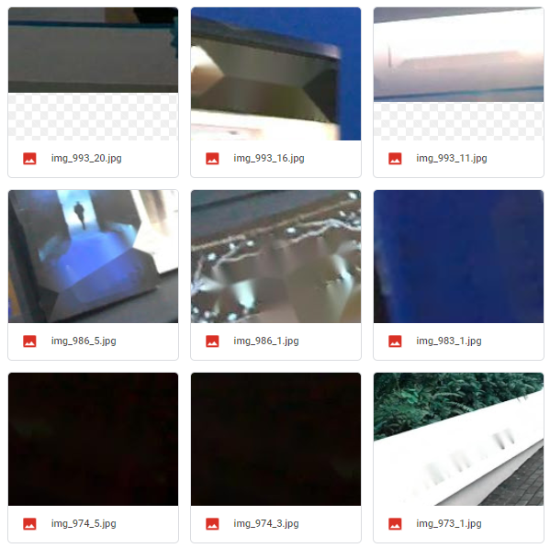
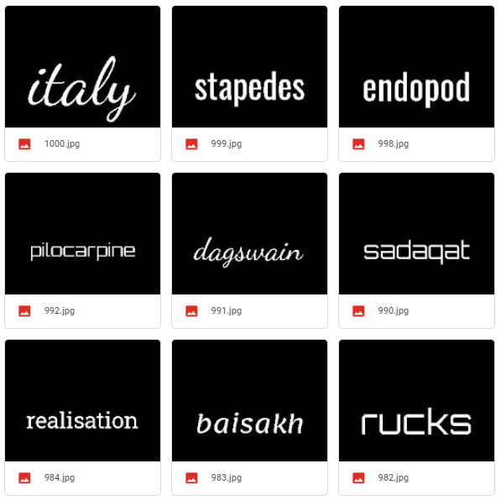
Dataset
Real
Background
Foreground

Slide 16
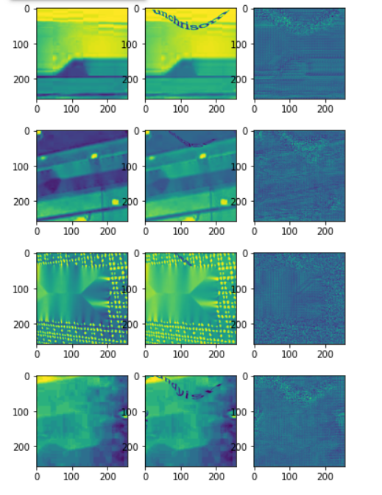
Running few iterations on the whole architecture...
Background
Composed
Synthesized

Slide 17
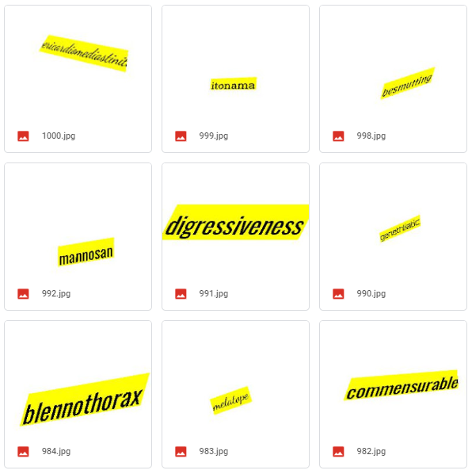
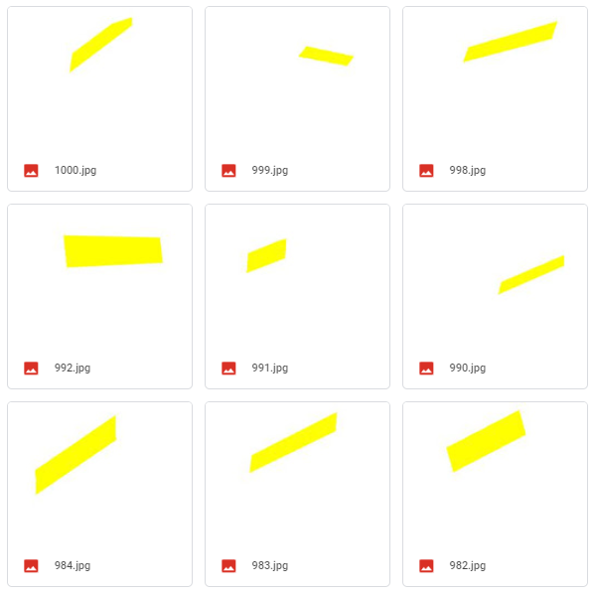
Smaller Problem: New Dataset
Real
Background
Foreground

Slide 18
Difficulty faced in Training GS
Transformation is not generalizing to background
The transformation parameters regressed by the localization network doesn’t seem to understanding the nuances of the background image and hence not changing w.r.t background.
Discriminator is getting too strong
In 4-5 epochs, the loss of discriminator sharply reduces to close to zero, hence making the training unstable.

Slide 19
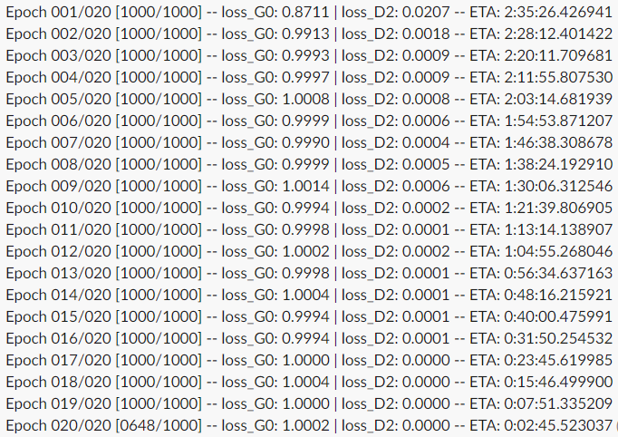
It leads to removing text from the composed image, i.e. composed image is same as the background image.
COLLAPSED!

Slide 20
Solution Tried:
Training discriminator once for every 5 iterations of generator.
Updating discriminator only if loss above a threshold of 0.1.
Updating discriminator only if d_loss > g_loss after 1st epoch.

Slide 21
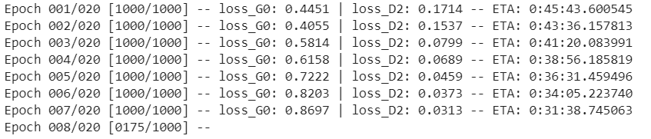
This is only slowing down the inevitable - discriminator growing too strong and suppressing the generator learning.

Slide 22
More Possible Solutions:
Label Smoothing
Adding Noise (similar to dropout)
Spectral Normalization
Wasserstein loss

Slide 23
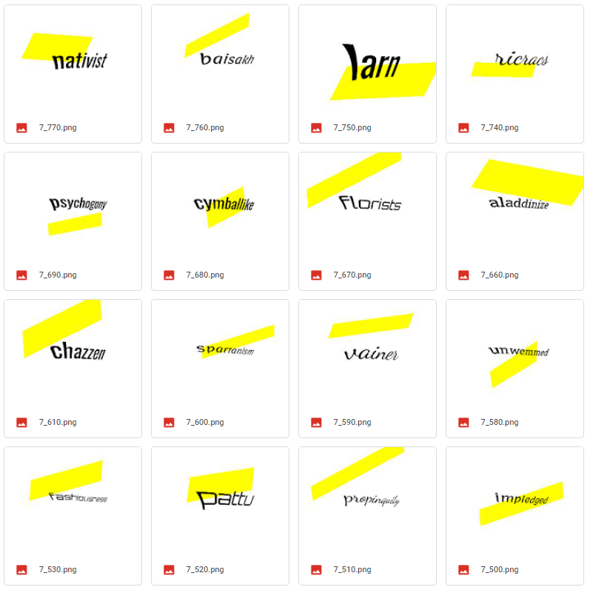
Few Observations...
Thin plate spline seems to perform poor on translation, rotation and scaling.
As we can see, all text transformation has similar translation, rotation and scaling, even after 7 epochs.

Slide 24
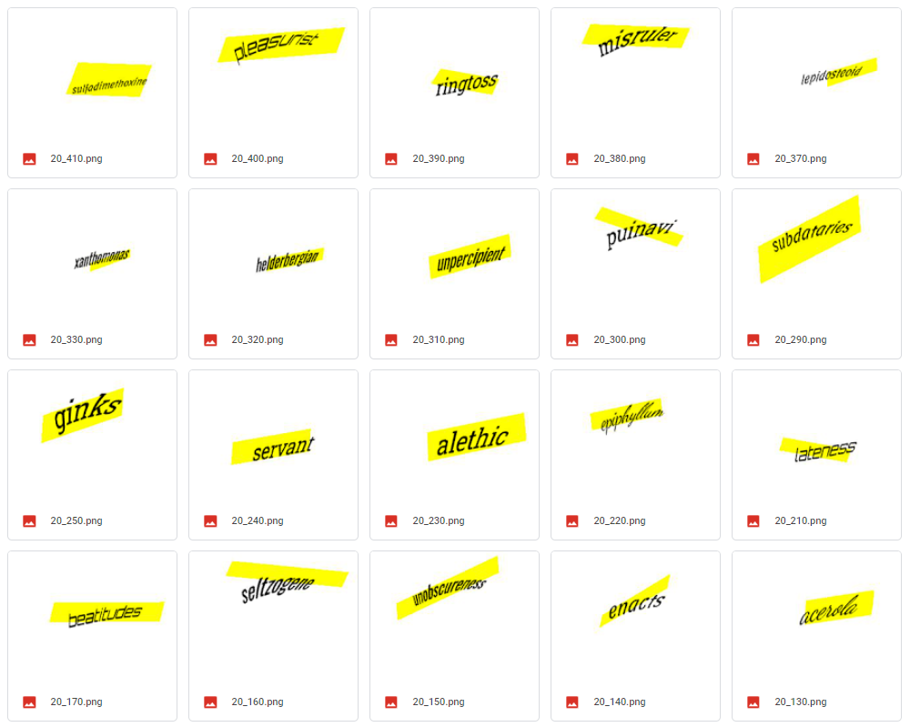
Idea: Use affine Transformation
Applied affine and thin plate spline sequentially on the input image.
We can see translations and scaling have significantly improved, though rotation needs more attention.

Slide 25
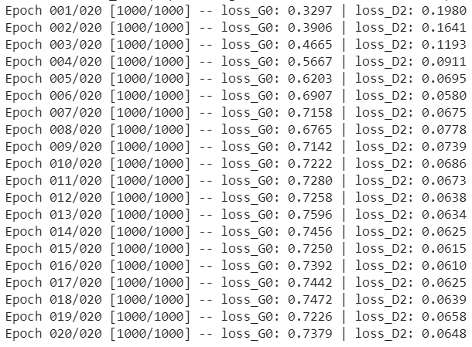
Looking at Loss Values...
Used 5:1 weighted updates for generator and discriminator

Slide 26
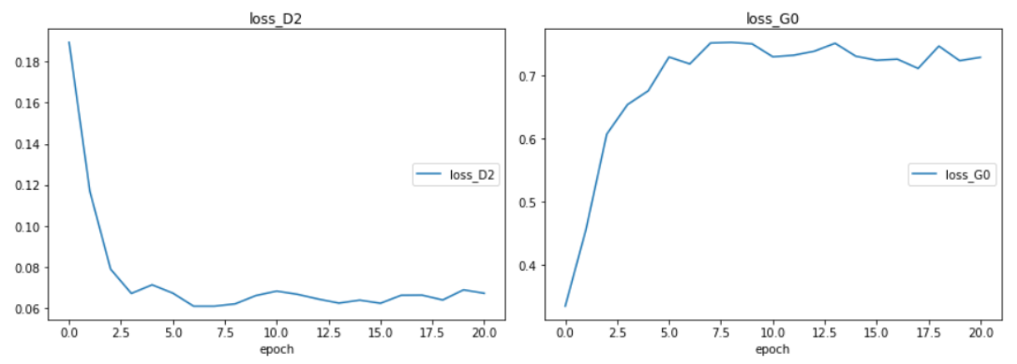
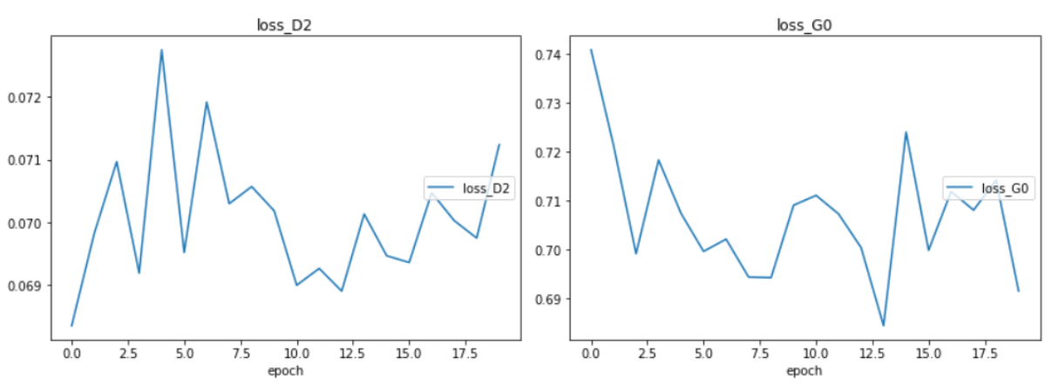
Spectral Normalization
Replacing every weight W in the network with W / σ(W)
Works better than BN in case of GANs

Slide 27
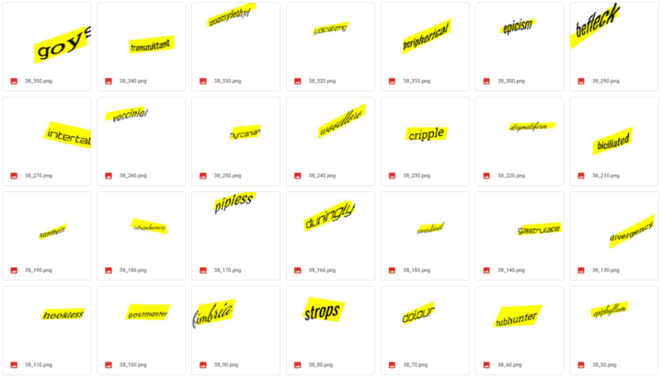
Looking at the outputs...
Rotational Transformation has improved significantly.

Slide 28
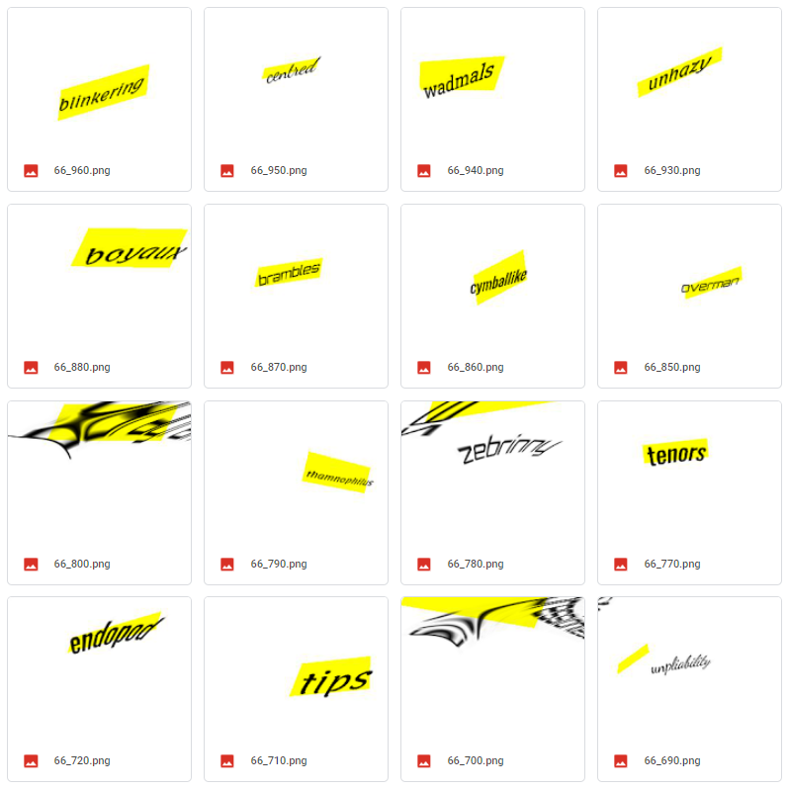
But, training is still unstable, after around 50 epochs, random transformation can be seen.

Slide 29
Next Steps...
Improving training stability
Improving original dataset and then applying the model to it
Appearance Synthesizer

Slide 30
Questions ?

Slide 31
Thank You!

